Slide 1
VISUAL C#.NET session 18 & 19
Instructor: Edwin oduor

Slide 2

Quote of the day

Slide 3
Lesson objectives
Altering a table
Creating relationships between tables
SQL Joins
Left join
Inner join
Right Join

Slide 4
Lesson pre-requisites
In order to take full advantage of this section you need to have the following;
Computer with Visual Studio Installed.
Stable Network Connection.

Slide 5
Training methods and extra readings
TRAINING METHODS FOR THIS LESSON
EXTRA READINGS
Lecturing Method – This is the main method of training to be adopted in this lesson with illustrations and practical coding examples.
Discussion Method - This method will be adopted periodically whereby learning will be derived principally from the students brainstorming together, rather than from the trainer. Three main types of discussions will be used:
Directed discussion
Developmental discussion
Problem-Solving discussion
Home and Learn C#

Slide 6
Alter table

Slide 7
What is altering a table?

Slide 8
To alter table in SQL is to make modification in the table created i.e. adding a new column, changing the name of column.

Slide 9

To Add column in a table
To modify the column name
To Drop a column
To rename a column

Slide 10
Creating relationships

Slide 11
To create relationships in tables is to link or relate data from one table to data from another table. This is achieved by use of primary key and foreign key.
A foreign key is a key in one table that refers to a primary key of another table.
To create a relationship then will alter the table so as to add a field that will be set as a foreign key.

Slide 12
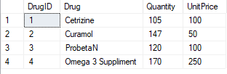

Product Table
Parent table
Make Purchase Table
Foreign key table
From the above tables the DrugID in the Make Purchase table is the foreign key table while DrugID in Product table is the parent table.

Slide 13
To link the two tables (create relationship), we use this code.
After creating relationships then the field DrugID in the Make Purchase table should be populated with DrugID from the product table.

Slide 14
Creating joins

Slide 15
Once relationships have been created, creating joins can now be possible, to create joins is to extract data from two tables and more by writing SQL code.

Slide 16
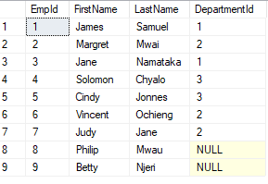

Creating joins
Will use the following Tables to understand the concept.
Employee1s table
Departments Table

Slide 17
Types of joins

Slide 18
1. Inner join
Inner Join is used to extract data that is common in both the tables as shown in the above illustration. From the above two tables we want to show employees with the department that they belong to. The output is going to be as shown below.
Inner Join

Slide 19
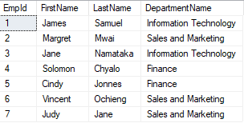
1. Inner join contd…
The code below will give us the output shown in the table above.

Slide 20
2. Left join
Left Join - Used to extract data that is in the left table and matching rows in the right table.
Left Table
Right Table

Slide 21
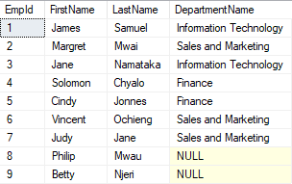
2. Let join contd…
Below table is as a result of left join.
Code to produce the table on the left.

Slide 22
Right join
Right Join – used to extract data that is in the right table and the matching rows on the left table.
Left table
right table

Slide 23
Right join contd…
To write code for the right join, the code should look like this.
NB: everything remains the same, the only part that changes is replace either right with inner or left depending on the kind of join that one wants to make.

